Slide 1
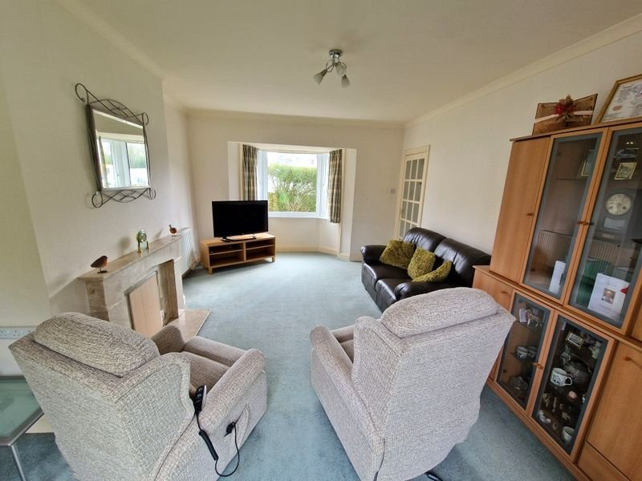
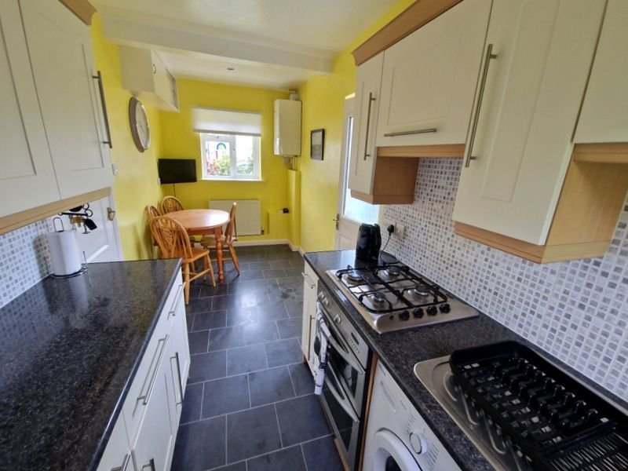
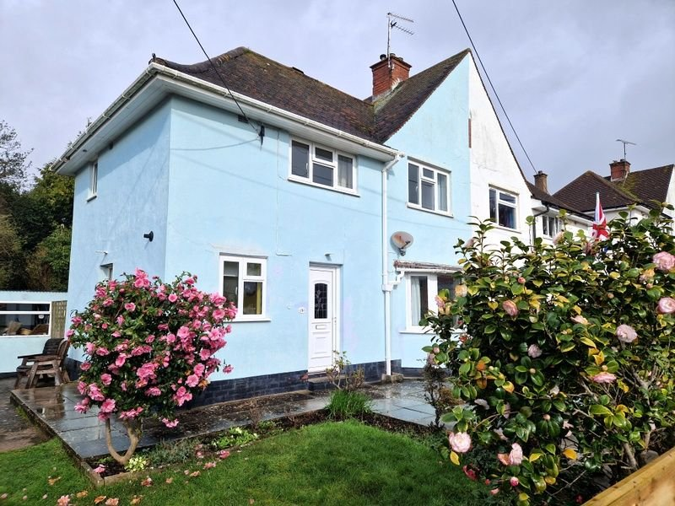
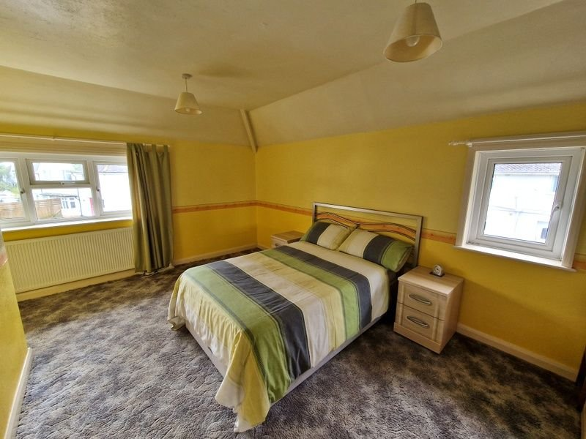
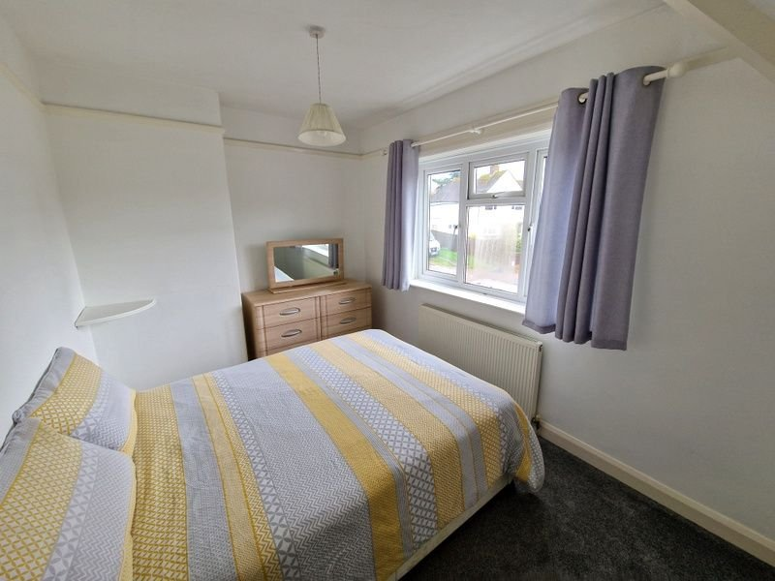
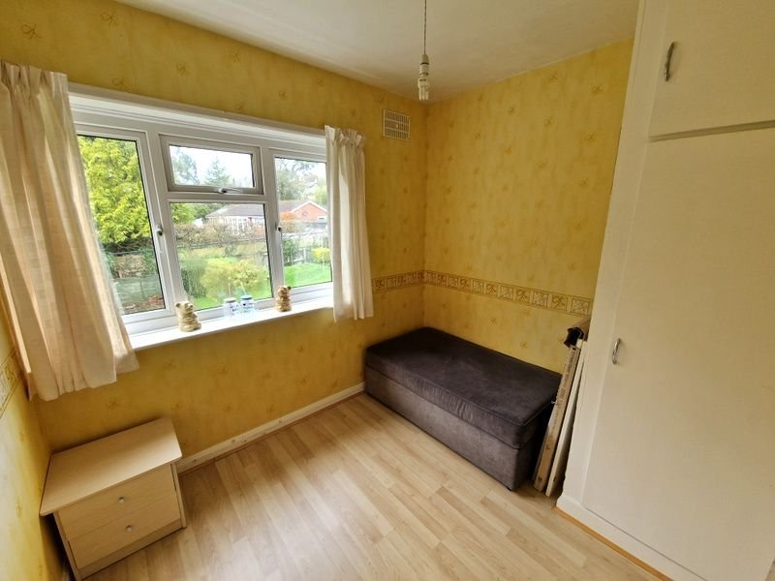
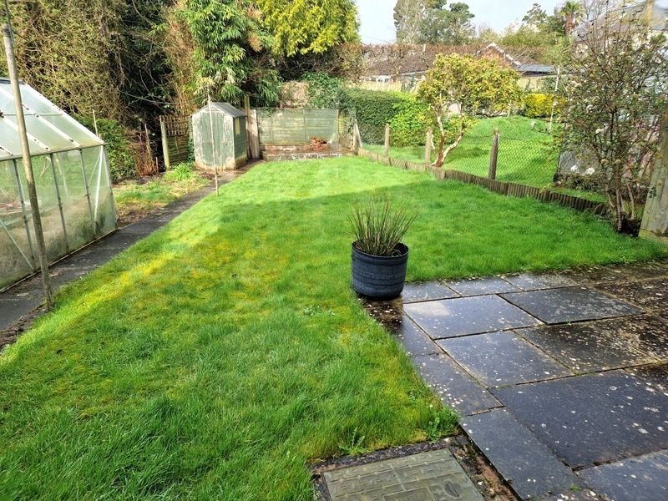
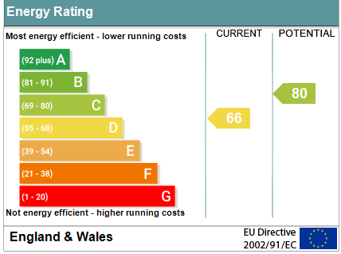
www.pennys.net
5 Meadow Road, Budleigh Salterton, EX9 6JL
GUIDE PRICE £339,950
TENURE Freehold
A Well Presented Semi-Detached House Located In A Sought After Area With Lovely Gardens And Offered For Sale With No Ongoing Chain
Through Lounge/Dining Room • Kitchen/Breakfast Room •
Ground Floor Shower Room/WC • Three Good Size First Floor Bedrooms •
Gas Central Heating • Double Glazed Windows •
Super Family Home •
Viewing Recommended •
Pennys Estate Agents Limited for themselves and for the vendor of this property whose agents they are give notice that:- (1) These particulars do not constitute any part of an offer or a contract. (2) All statements contained in these particulars are made without responsibility on the part of Pennys Estate Agents Limited. (3) None of the statements contained in these particulars are to be relied upon as a statement or representation of fact. (4) Any intending purchaser must satisfy himself/herself by inspection or otherwise as to the correctness of each of the statements contained in these particulars. (5) The vendor does not make or give and neither do Pennys Estate Agents Limited nor any person in their employment has any authority to make or give any representation or warranty whatever in relation to this property.
PENNYS ESTATE AGENTS
2 Rolle House, Rolle Street, Exmouth, Devon, EX8 2SN
Tel: 01395 264111 EMail: help@pennys.net

Slide 2
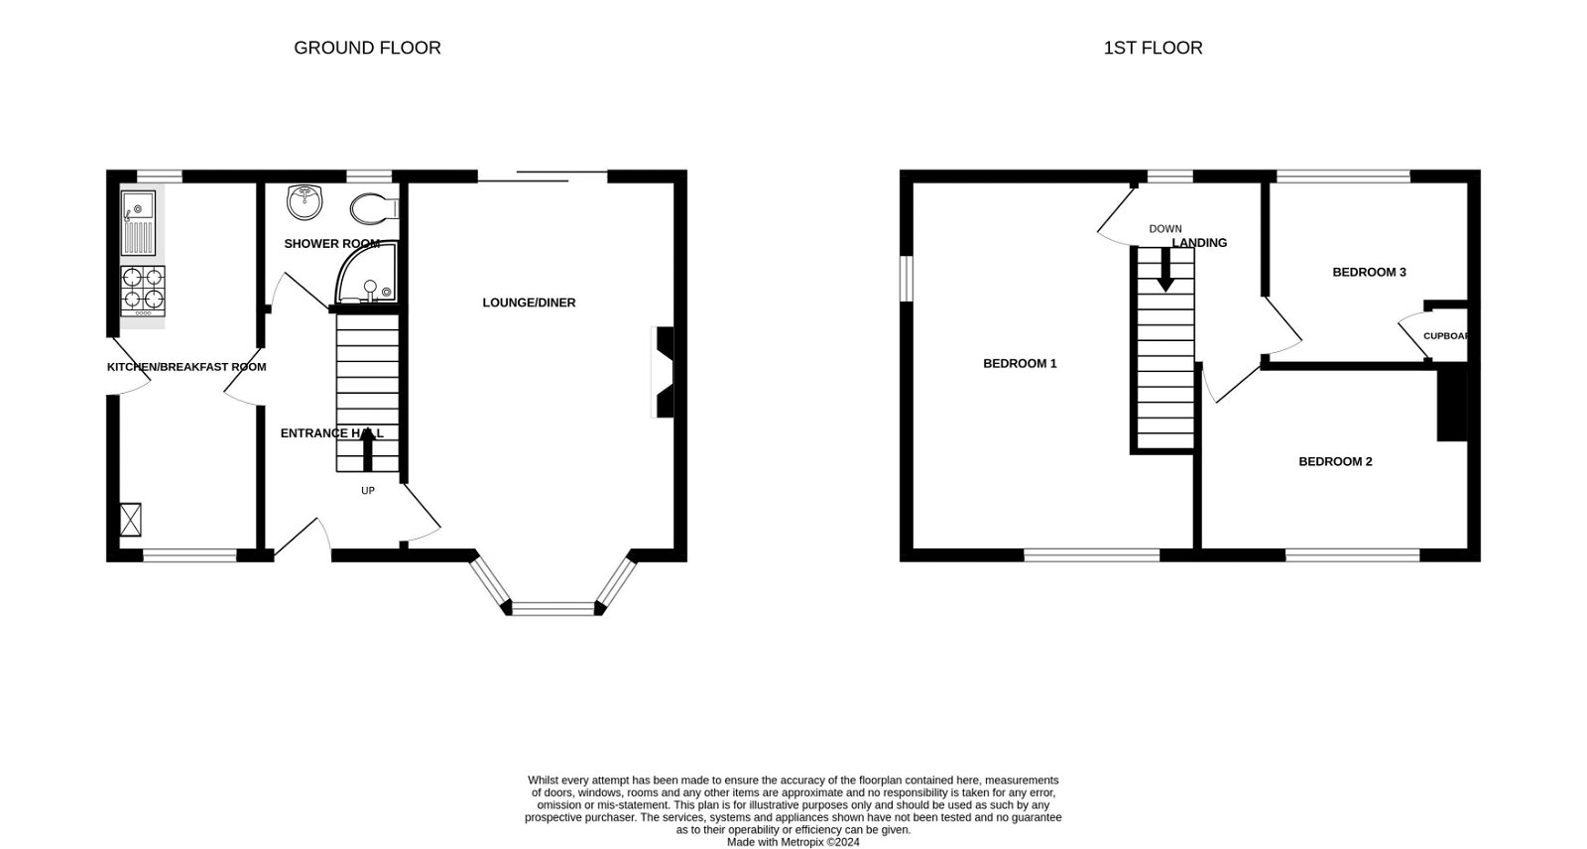
5 Meadow Road, Budleigh Salterton, EX9 6JL
THE ACCOMMODATION COMPRISES: uPVC double glazed front door to: RECEPTION HALL: Radiator; stairs to first floor landing with understairs cupboard; recess ceiling spotlighting. LOUNGE/DINING ROOM: 5.72m x 3.66m (18'9" x 12'0") into uPVC double glazed bay window to front aspect. A lovely bright room with sliding patio doors to rear garden; marble fireplace with matching hearth; television point; radiator. KITCHEN/BREAKFAST ROOM: 5m x 1.96m (16'5" x 6'5") Comprising of pattern worktop surfaces with cupboards, drawer units and plumbing for an automatic washing machine; inset single drainer sink unit with tiled surrounds; four ring gas hob with oven beneath and extractor hood over; eye level cupboards; two uPVC double glazed windows to front and rear aspects; space for fridge freezer; wall mounted Worcester gas boiler; part glazed door to outside; recess ceiling spotlighting; television point; cupboard housing electric meter. GROUND FLOOR SHOWER ROOM/WC: 1.96m x 1.55m (6'5" x 5'1") Shower cubicle; pedestal wash hand basin; WC; fully tiled walls; mirror fronted medicine cabinet; chrome heated towel rail; recess ceiling spotlighting; uPVC double glazed window with pattern glass. FIRST FLOOR LANDING: uPVC double glazed window to rear aspect; access to loft space; doors to: BEDROOM ONE: 5.05m x 4.65m (16'7" x 15'3") into wall recess narrowing to 10'0". A spacious dual aspect main bedroom with uPVC double glazed windows to front and side aspects; radiator. BEDROOM TWO: 3.68m x 2.49m (12'1" x 8'2") uPVC double glazed window to front aspect; radiator. BEDROOM THREE: 2.64m x 2.44m (8'8" x 8'0") uPVC double glazed window to rear aspect; radiator; laminate floor; linen cupboard. OUTSIDE: Standing in beautiful generous size gardens with brook to one side. The property is approached via pedestrian gate and patio pathway to front garden which is laid to lawn with patio area, decorative stone garden area and shrub beds. Side gate with further patio/seating area and lawn leads through to the rear garden. The rear garden is mainly laid to lawn with substantial store, greenhouse, timber shed, vegetable plot, two patio areas at the end of the garden.
FLOOR PLAN:

